Slide 1
AIR QUALITY ANALYSIS AND PREDICTION IN TAMIL NADU
Submitted By
G. Balasurya
Dept. of Electronics and Communication Engineering
Anna University Regional Campus Coimbatore

Slide 2
Problem Statement
The objective of this project is to analyze and visualize air quality data from various monitoring stations in Tamil Nadu. The dataset contains measurements of Sulfur Dioxide (SO2), Nitrogen Dioxide (NO2), and Respirable Suspended Particulate Matter/Particulate Matter 10 (RSPM/PM10) levels in different cities, towns, villages, and areas. The project aims to gain insights into the air pollution trends, identify areas with high pollution levels, and create a predictive model to estimate RSPM/PM10 levels based on SO2 and NO2 levels.

Slide 3
AIR POLLUTION
Air pollution, primarily driven by industrialization, urbanization, and transportation, has emerged as a critical global issue. It poses significant threats to human health, ecosystems, and the climate. Poor air quality, characterized by elevated levels of pollutants such as particulate matter (PM), nitrogen oxides (NOx), and carbon monoxide (CO), is associated with respiratory diseases, cardiovascular problems, and even premature mortality.

Slide 4
Air Quality Analysis and Managament
Air quality management is an essential component of environmental stewardship aimed at safeguarding public health and the natural world.
To address these challenges, air quality management employs a multi-faceted approach. It encompasses monitoring and assessment of air quality through extensive networks of monitoring stations and advanced sensor technologies.

Slide 5
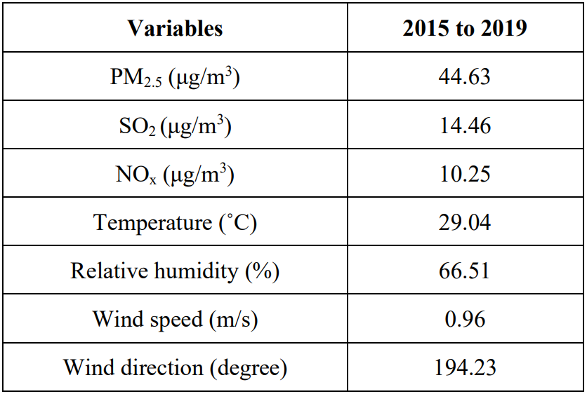
METHODS AND MATERIALS
Data Sets
The first and foremost step in modelling is to collect and group the relevant data, both past data and data from air quality monitoring.

Slide 6
METHODS AND MATERIALS
Modelling
The second step to the modelling process is the implementation of the modelling software, this research uses Artificial Neural Network to determine the input and output of the model. Preprocessing of data, removing errors in data and dividing for training, validation and evaluation has to be done to get better results. After this data is ready to be implemented in ANN.

Slide 7
METHODS AND MATERIALS
Validation
The third step involves the validation of the model. It will define the quality of the model and the response as the training process when completed. A prepared set of the input and output data were used to validate the model and the data response is compared with modelled and measured.

Slide 8
METHODS AND MATERIALS
Evaluation
The next step is to evaluate the model, with the response of training or validation process.
Mean Squared Error (MSE),
Root Mean Squared Error (RMSE),
Mean Absolute Error (MAE),
Mean Squared Relative Error (MSRE),
Coefficient of Determination (R2),
Index of Agreement,
Percentage to BIAS (PBIAS),
Root Mean Squared Error to Standard Deviation (RSR) are recommended.

